Slide 1
Conxillium

Slide 2
Node JS
Agenda
Node.js
Node Module System
Node Package Manager (NPM)
Use of Package.json
Simple REST API with node + Express

Slide 3

Node JS – What is?
Node is not a framework, it just a runtime environment for executing JavaScript code.
1. JavaScript everywhere
2. Superfast and highly scalable
3. Great for prototyping and agile development
4. large ecosystem of open-source libs (NPM)

Slide 4
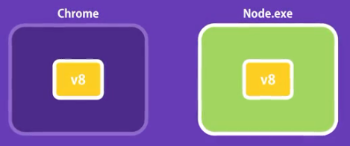
Node JS – What is?
Node is a C++ program which wraps chromes v8 JavaScript engine.
Single threaded, non-blocking Asynchronous architecture by default.
Ideal for I/O intensive apps, not for CPU-intensive apps (video processing)

Slide 5
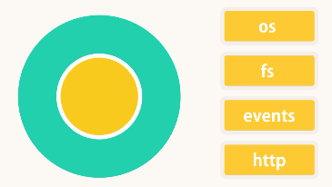
Node Module System
Node has a global object, same as window object in browser.
Encapsulate code inside modules.

Slide 6
Node Core useful modules { Coding… }
Install node https://nodejs.org/en/download/
Check ☺ >>node –version
{ Coding… }
try out several core modules… [ os, fs, http ]
https://nodejs.org/docs/latest-v9.x/api/os.html

Slide 7

Node Package Manager ( NPM )
Installed with node, check >>npm –v
https://www.npmjs.com/
NPM is a package manager for Node.js packages, npm is the world's largest Software Registry. The registry contains over 800,000 code packages.
Create a new Project with npm.. >>npm init –yes
Install a package and use it (Coding..)
Notes:
Every node_module has a package.json themselves

Slide 8
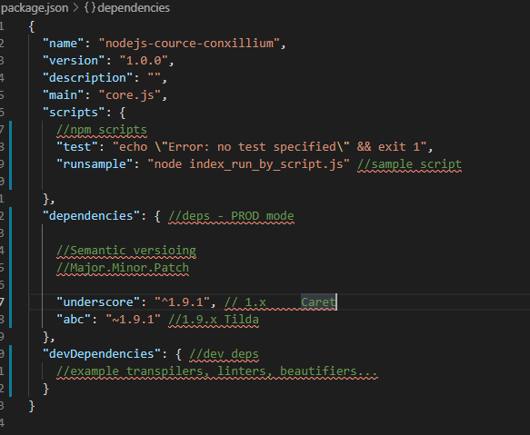
Package.json
Dependancies
Dev-Dependancies
NPM scripts
Semantic Versioining
Notes:
Every node_module has a package.json themselves

Slide 9
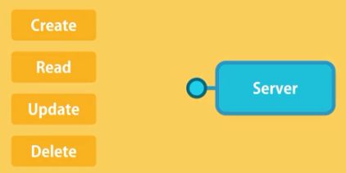
RESTful API’s using Express.js
Install express >> npm I express (Coding…)
Notes:
Every node_module has a package.json themselves

Slide 10

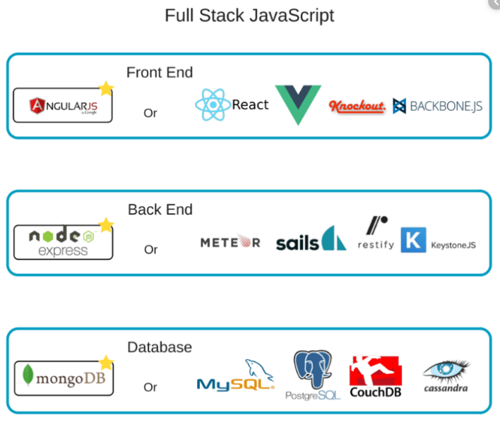
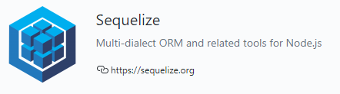
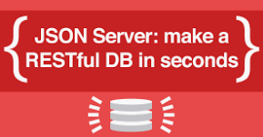
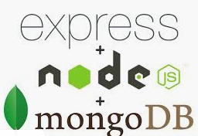
Note
Node js is well matuared. Can build anything.. Search You fill find them... ☺
Thank You

